Slide 1

Optimizing trial power using metaheuristic algorithms
http://med.stanford.edu/cisd.html

Slide 2
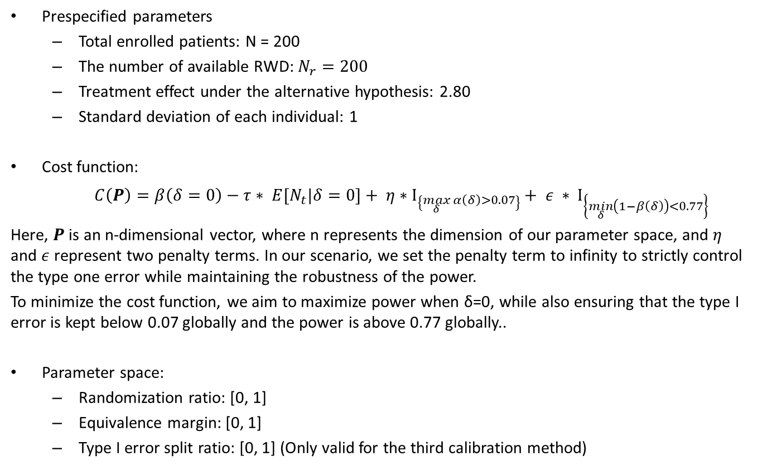
Hybrid Design
Prespecified parameters
Total enrolled patients: N = 200
The number of available RWD: $N_{r}=200$
Treatment effect under the alternative hypothesis: 2.80
Standard deviation of each individual: 1
Cost function:
$C\left(P\right)=β\left(δ=0\right){ − τ∗ E[N}_{t}|δ=0]+ η∗Ι_{\left\{\max_{δ}{α\left(δ\right)}>0.07\right\}}+ ε ∗ Ι_{\left\{\min_{δ}\left(1−β\left(δ\right)\right)<0.77\right\}}$
Here, $P$ is an n-dimensional vector, where n represents the dimension of our parameter space, and $η$ and $ε$ represent two penalty terms. In our scenario, we set the penalty term to infinity to strictly control the type one error while maintaining the robustness of the power.
To minimize the cost function, we aim to maximize power when δ=0, while also ensuring that the type I error is kept below 0.07 globally and the power is above 0.77 globally..
Parameter space:
Randomization ratio: [0, 1]
Equivalence margin: [0, 1]
Type I error split ratio: [0, 1] (Only valid for the third calibration method)

Slide 3
Hybrid Design
Optimization results:
 | Randomization Ratio | Patients in Treatment Arm | Equivalence Margin | Borrowing Probability at δ = 0 | Type I error split proportion
Reference | 0.50 | 100 | 0.30 | 76%
Calibration1_CSO | 0.76 | 152 | 0.33 | 57%
Calibration1_CSOMA | 0.72 | 144 | 0.32 | 59%
Calibration1_PSO | 0.77 | 153 | 0.34 | 57%
Calibration2_CSO | 0.35 | 69 | 0.27 | 75%
Calibration2_CSOMA | 0.34 | 68 | 0.27 | 75%
Calibration2_PSO | 0.34 | 67 | 0.28 | 76%
Calibration3_CSO | 0.49 | 97 | 0.29 | 72% | 54%
Calibration3_CSOMA | 0.50 | 100 | 0.29 | 70% | 53%
Calibration3_PSO | 0.51 | 101 | 0.29 | 70% | 53%
Calibration4_CSO | 0.58 | 115 | 0.29 | 67%
Calibration4_CSOMA | 0.58 | 116 | 0.29 | 66%
Calibration4_PSO | 0.58 | 116 | 0.29 | 66%

Slide 4
Hybrid Design
Calibration 1:
Type I error:
δ = 0 : There is a slight increase in type I error when δ = 0. This is because we reject the primary test based on the assumption that the overall test statistics W are normally distributed. However, when δ = 0, the distribution of the overall test statistic W is a combination of two normal distributions, one with a larger variance and the other with a lower variance. This mixed distribution has a heavier tail than a normal distribution. Therefore, if we reject the null hypothesis of the primary test, there will be a slight inflation in type I error.
|δ| > 0: The inflation of type I error persists because we calculated the variance of the overall test statistics assuming that δ = 0. The variance turns out to be larger than the pooled estimate and smaller than the original estimator. When δ is significant, the overall test statistic converges to a normal distribution. However, we end up rejecting the null hypothesis of the primary test using a smaller variance, leading to type I error inflation.
Power:
δ = 0 : There is a gain in power as the overall test statistic has a smaller variance.
|δ| > 0: Even when δ is significant, and borrowing probability is small. There is a power gain as well, this is because of the same reason of type I error inflation when |δ| > 0

Slide 5
Hybrid Design
Calibration 2:
Type I error:
δ = 0 : Type I error equal 0.05.
|δ| > 0: Type I error is below 0.05. This is due to when we do calibration on the cutoff value, we sacrificed the type I error when we will not borrow RWD, i.e., we choose a larger cutoff value when we borrow the RWD
Power:
δ = 0 : There is a gain in power because of additional sample size when borrowing the RWD.
|δ| > 0: The power will drop below the reference line (80%). This is due to the same reason of the reduced type I error when |δ| > 0

Slide 6
Hybrid Design
Calibration 3:
Type I error:
δ = 0 : Type I error equal 0.05.
|δ| > 0: This calibration method is a generalization of the calibration 2 and 4. If we choose the split proportion as one minus the power of the equivalence test, then this calibration method is the same as the fourth calibration method. If we choose the split proportion such that the two cutoff value are the same, then this calibration method is the same as the second calibration method. If the split ratio is lower than one minus the power of the equivalence test, the type I error will be lower than 0.05 when δ is significant. If we choose the split ratio greater than one minus the power of the equivalence test, then the type I error will be greater than 0.05 when δ is significant. This is due to when we choose the split ratio, we may reduce or the type I error when we will not borrow RWD, i.e., we choose a larger cutoff value when we borrow the RWD
Power:
δ = 0 : There is a gain in power because of additional sample size when borrowing the RWD.
|δ| > 0: The power may drop below or increase about the reference line (80%). This depends on the split ratio we choose.

Slide 7
Hybrid Design
Calibration 4:
Type I error:
δ = 0 : Type I error equal 0.05.
|δ| > 0: The type I error will go back to 0.05. This is because we increase the cutoff value when we borrow the RWD and remain the other cutoff value as the same
Power:
δ = 0 : There is a gain in power because of additional sample size when borrowing the RWD.
|δ| > 0: Similarly, the power will go back to the reference line (80%)

Slide 8
Hybrid Design

Slide 9
Hybrid Design

Slide 10
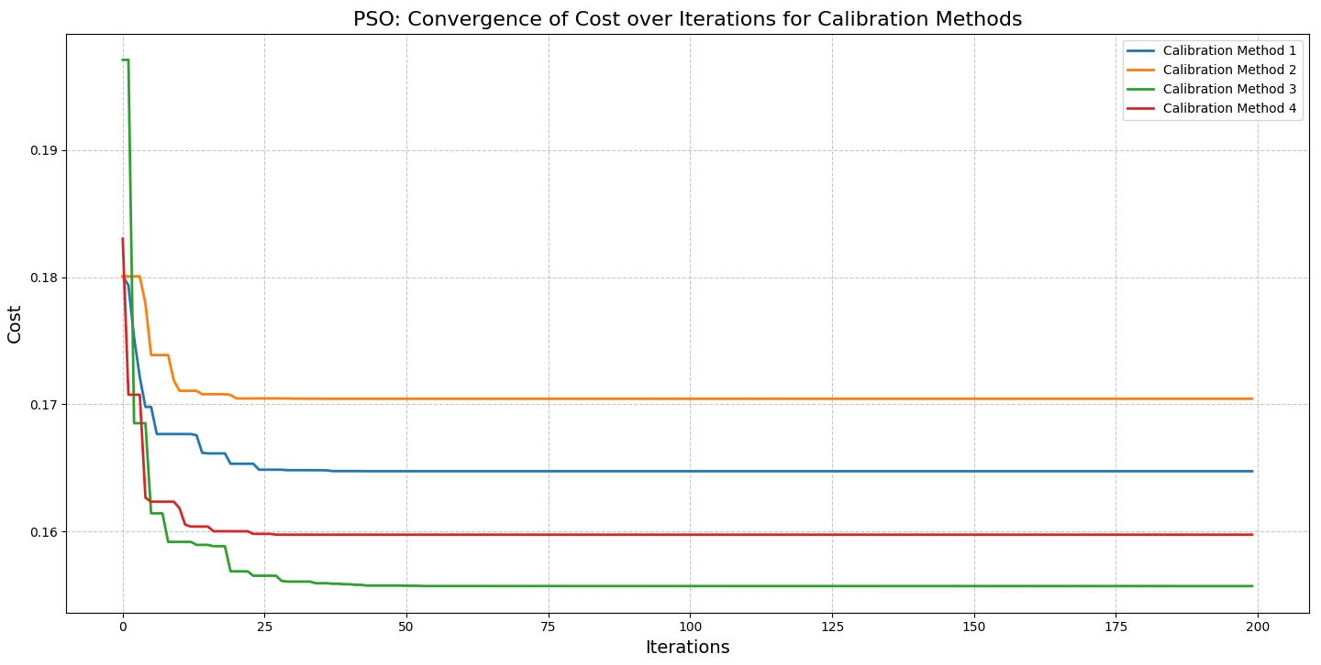
Hybrid Design - PSO

Slide 11
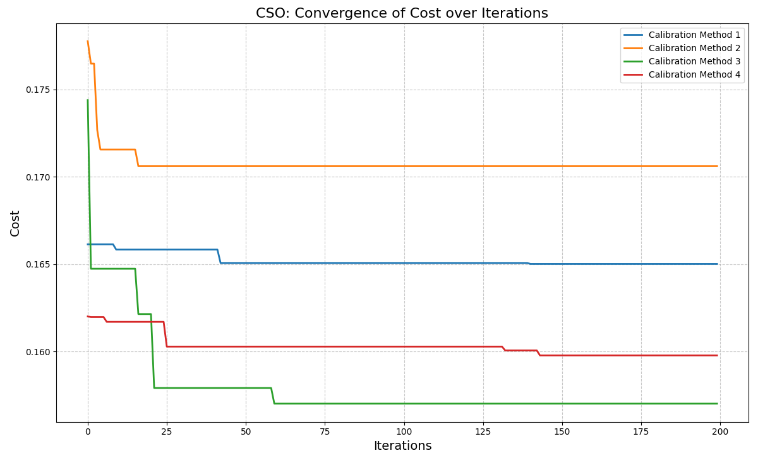
Hybrid Design - CSO

Slide 12
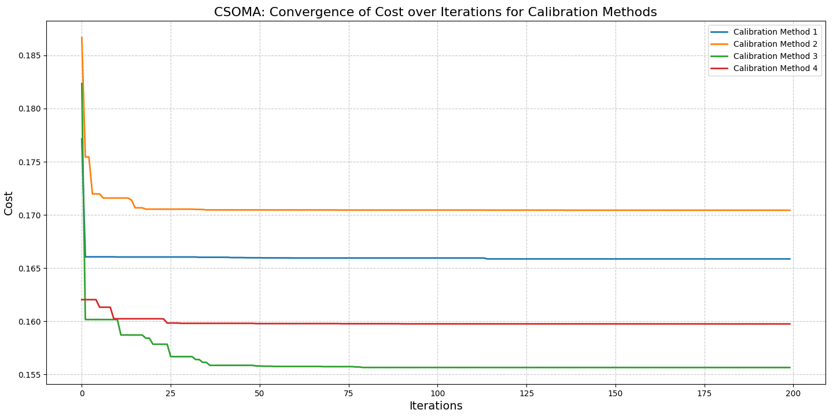
Hybrid Design - CSOMA

Slide 13
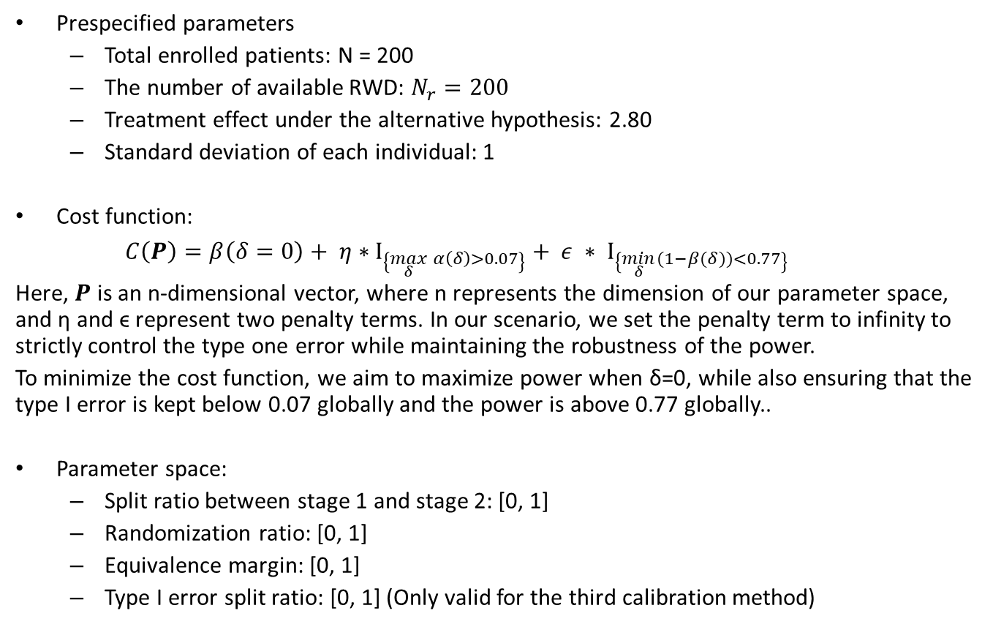
Hybrid Design
Prespecified parameters
Total enrolled patients: N = 200
The number of available RWD: $N_{r}=200$
Treatment effect under the alternative hypothesis: 2.80
Standard deviation of each individual: 1
Cost function:
$C\left(P\right)=β\left(δ=0\right)+ η∗Ι_{\left\{\max_{δ}{α\left(δ\right)}>0.07\right\}}+ ε ∗ Ι_{\left\{\min_{δ}{(1−β(δ))}<0.77\right\}}$
Here, $P$ is an n-dimensional vector, where n represents the dimension of our parameter space, and η and ϵ represent two penalty terms. In our scenario, we set the penalty term to infinity to strictly control the type one error while maintaining the robustness of the power.
To minimize the cost function, we aim to maximize power when δ=0, while also ensuring that the type I error is kept below 0.07 globally and the power is above 0.77 globally..
Parameter space:
Split ratio between stage 1 and stage 2: [0, 1]
Randomization ratio: [0, 1]
Equivalence margin: [0, 1]
Type I error split ratio: [0, 1] (Only valid for the third calibration method)

Slide 14
Sequential Design
Optimization results:
 | Split ratio between stage 1 and stage 2 | Patients allocated to stage 1 | Randomization Ratio at stage 2 | Patients in treatment arm of stage 2 | Equivalence Margin | Borrowing probability | Split proportion of type I error rate
Calibration1_CSO | 0.84 | 168 | 0.7976 | 26 | 0.2706 | 58%
Calibration1_CSOMA | 0.85 | 170 | 0.7 | 21 | 0.2752 | 60%
Calibration1_PSO | 0.885 | 177 | 0.7627 | 18 | 0.2761 | 62%
Calibration2_CSO | 0.795 | 159 | 0.7987 | 33 | 0.2641 | 52%
Calibration2_CSOMA | 0.725 | 145 | 0.5931 | 33 | 0.2756 | 53%
Calibration2_PSO | 0.76 | 152 | 0.6842 | 33 | 0.2704 | 53%
Calibration3_CSO | 0.85 | 170 | 0.6941 | 21 | 0.2763 | 61% | 68%
Calibration3_CSOMA | 0.865 | 173 | 0.6532 | 18 | 0.2809 | 63% | 59%
Calibration3_PSO | 0.875 | 175 | 0.6743 | 17 | 0.28 | 63% | 61%
Calibration4_CSO | 0.9 | 180 | 0.7833 | 16 | 0.2816 | 65%
Calibration4_CSOMA | 0.89 | 178 | 0.7247 | 16 | 0.2817 | 65%
Calibration4_PSO | 0.885 | 177 | 0.7345 | 17 | 0.2811 | 64%

Slide 15
Sequential Design

Slide 16
Sequential Design

Slide 17
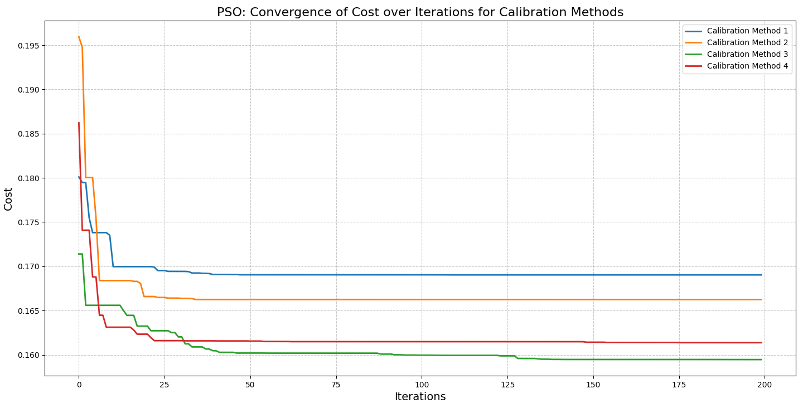
Sequential Design - PSO

Slide 18
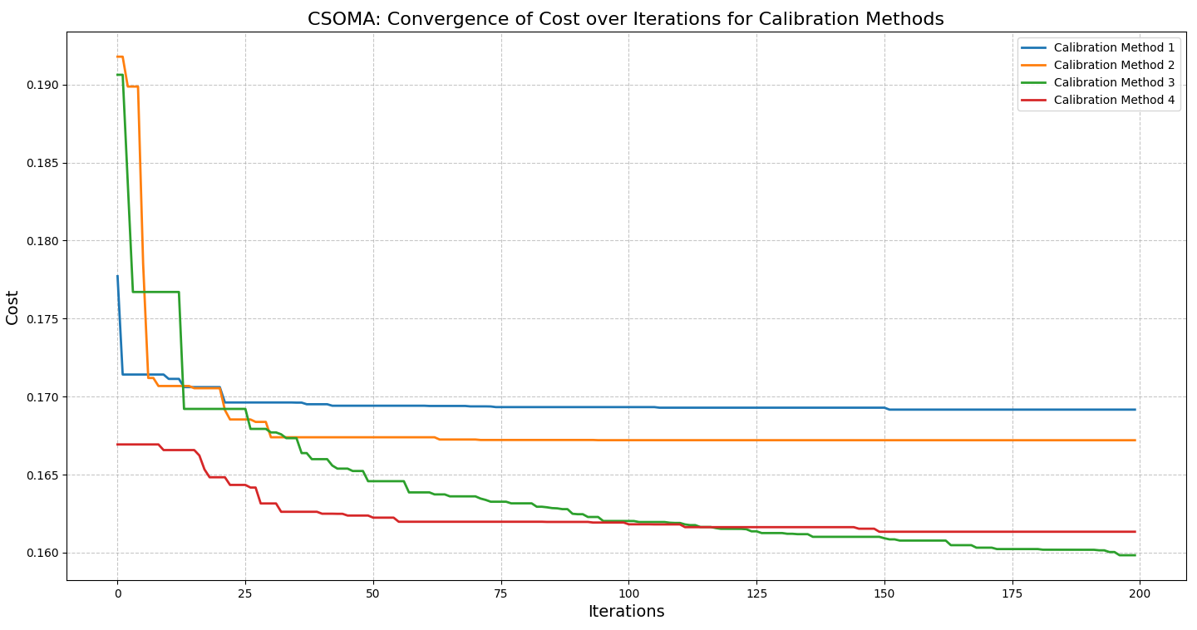
Sequential Design - CSOMA

Slide 19
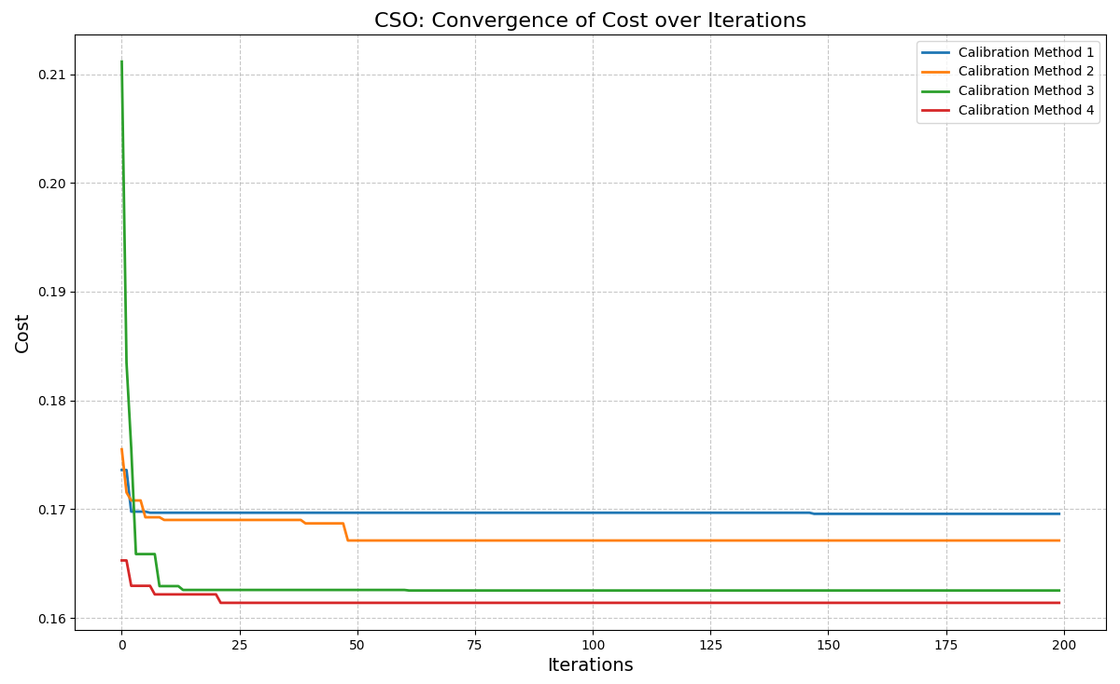
Sequential Design - CSO

